Slide 1

CSE 2213: Discrete Mathematics Section - O Room No – 325 Counting: Product Rule, Sum Rule and Pigeon Hole
Prof. Dr. A.K.M. Muzahidul Islam
Computer Science & Engineering (CSE)
United International University (UIU)
Email: muzahid@cse.uiu.ac.bd
Fall 2024

Slide 2
Basic counting principles
Product Rule
Sum Rule

Slide 3
The product rule

Slide 4
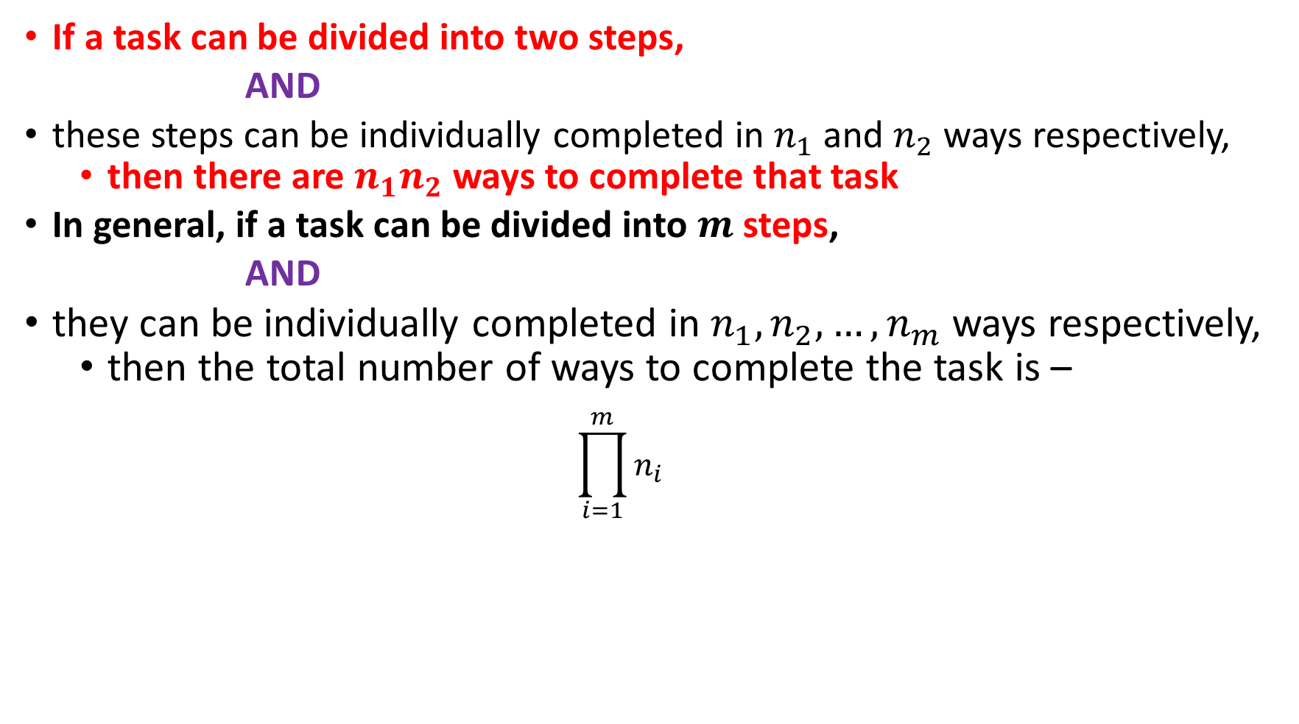
Product Rule
If a task can be divided into two steps,
AND
these steps can be individually completed in $n_{1}$ and $n_{2}$ ways respectively,
then there are $n_{1}n_{2}$ ways to complete that task
In general, if a task can be divided into $m$ steps,
AND
they can be individually completed in $n_{1},n_{2},…,n_{m}$ ways respectively,
then the total number of ways to complete the task is –
$$\prod_{i=1}^{m}{n_{i}}$$

Slide 5
Solving a problem using Product Rule
Step 1: Identify the Steps
Step 2: Count the possible ways for each Step
Step 3: Multiply the possible ways

Slide 6
Product Rule: Example
Birthday Treat
Suppose, you want to give birthday treat to your friends in a restaurant.
The restaurant offers 3 main courses (e.g., Biryani, Pizza, Pasta) and 2 types of cold drinks (Pepsi, 7Up).
Your friend can choose one main course and one cold drink from the given options.
Q. How many different choices does your friend have to select the meal ?

Slide 7
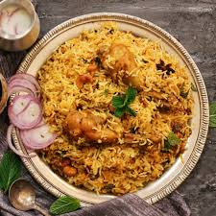
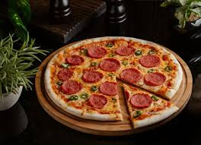
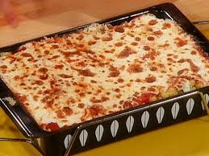


Product Rule
You have to select two items from the menu.
One from the main course, for that you have total three choices.
Another one from the cold drinks, for that you have two options.

Slide 8

Product Rule
If you choose Biryani, then you can take pepsi or 7up with it. Therefore, you have two different choices

Slide 9
Product Rule
If you choose Pizza, then you can take pepsi or 7up with it. Therefore, you have two choices.

Slide 10
Product Rule
If you choose Pasta, then you can take pepsi or 7up with it. Therefore, you have two choices.

Slide 11
Product Rule
Step one: Identify the subtasks
The subtasks SHOULD be done ONE AFTER THE OTHER to make the whole task possible.
The subtasks are connected using AND relationship
In previous example the task GIVING TREAT consisted of two subtasks
SELECTING A MAIN COURSE
SELECTING A DRINK
Step two: Count the possible ways for each subtask
SELECTING A MAIN COURSE – 3 ways
SELECTING A DRINK – 2 ways
Step three : Multiply the possible ways of the subtasks
This gives the possible ways the task can be done
In 3 × 2 = 6 ways you can treat your friends

Slide 12
Product Rule: Example
Important Note:
The first subtask reducing the options for the second subtask
There are twelve empty rooms in the office of Google. Mamun and Moon joins the company. How many ways can they be assigned a room each from these twelve?
Let us follow the steps again

Slide 13
Product Rule
Total choice for Mamun= 12

Slide 14
Product Rule
Mamun
Total choice for Moon= 11

Slide 15
Product Rule
Total choice for Moon= 11
Mamun

Slide 16
Product Rule
Total choice for Moon= 11
Mamun

Slide 17
Product Rule
For every possible room assignment for Mamun,
there are 11 choices for Moon
Total no. of assignments = 12x11 = 132
Mamun

Slide 18

Tour de Saint Martins
The tour is divided into 03 parts:
Dhaka to Chattogram by train,
Chattogram to Teknaf by bus, and
Teknaf to Saint Martins by ship
There are 4 trains from Dhaka to Chattogram
Subarna Express,
Sonar Bangla Express,
Mahanagar Provati,
Turna Nishitha
There are 5 buses from Chattogram to Teknaf
Hanif, Shyamoli, S Alam, Green Line, Ena
There are 3 ships from Teknaf to Saint Martins
Keari Sindbad, Kutubdia, Green Line Water Bus
Q. How many possible ways to reach Saint Martins from Dhaka?

Slide 19
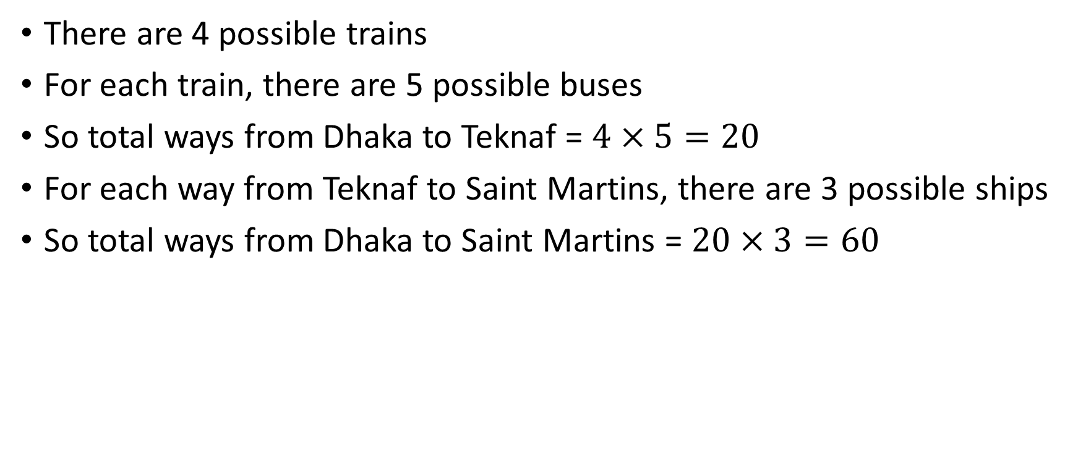
Solution
There are 4 possible trains
For each train, there are 5 possible buses
So total ways from Dhaka to Teknaf = $4×5=20$
For each way from Teknaf to Saint Martins, there are 3 possible ships
So total ways from Dhaka to Saint Martins = $20×3=60$

Slide 20
Observation: When do we need to multiply?
The tour is divided into three parts
Dhaka to Chattogram,
Chattogram to Teknaf,
Teknaf to Saint Martins
Every part is essential in order to reach Saint Martins
These 03 parts are the 03 steps to reach Saint Martins
If you are given the steps to complete a task, you can calculate the number of ways to do it by multiplying the individual numbers of ways to complete the steps

Slide 21
Example
Let’s consider that we need to complete 2 Tasks : T1 and T2
Let’s also consider that to complete T1 tasks there are n1 ways
T2 tasks there are n2 ways
T1 and T2 : Independent i.e. no relationship between T1 and T2
Thus, there are n1 x n2 ways to complete these tasks.
Example:
Given 04 Students: A, B, C and D
We need to choose 02 students from here (In order i.e. AB and BA are not same).
Out of 4 students 01 can be selected for T1 i.e., n1 ways = 4
Out of 4 students another 01 can be selected for T2 i.e., n2 ways = 3
Thus, there are 4 x 3 = 12 ways

Slide 22
Product Rule: More Examples
What is the total number of possible bit strings of length 7?
How many different license plates are available if each plate contains a sequence of three lowercase letters followed by three digits?

Slide 23
The sum rule

Slide 24
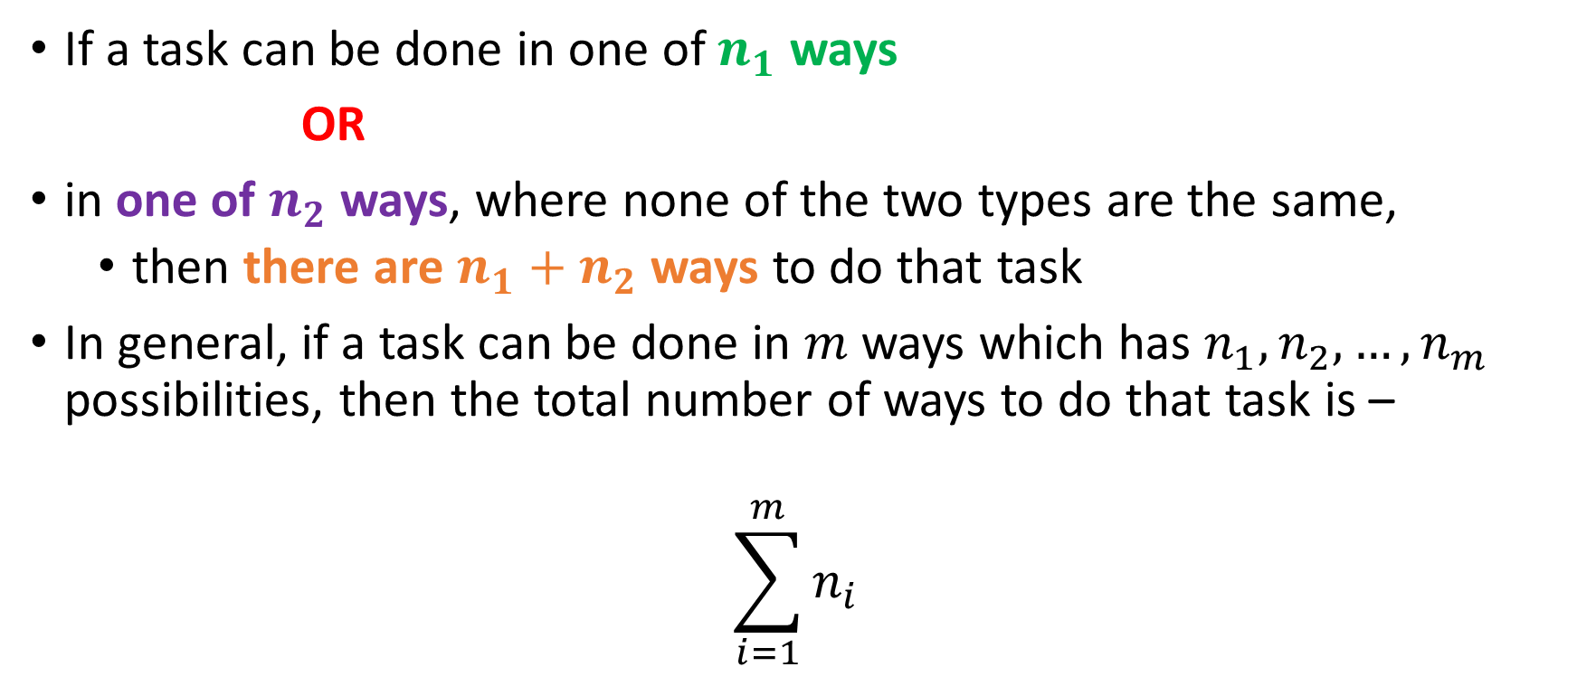
The Sum Rule
If a task can be done in one of $n_{1}$ ways
OR
in one of $n_{2}$ ways, where none of the two types are the same,
then there are $n_{1}+n_{2}$ ways to do that task
In general, if a task can be done in $m$ ways which has $n_{1},n_{2},…,n_{m}$ possibilities, then the total number of ways to do that task is –
$$\sum_{i=1}^{m}{n_{i}}$$

Slide 25
Solving a problem using sum rule
Step 1: Identify the different options
Step 2: Count the possible ways for each options
Step 3: Add the possible ways

Slide 26
Example
During FYDP at UIU, Dr. X offers 4 projects, Dr. Y offers 5 projects and Dr. Z offers 7 projects to work on.
Assuming their disciplines are different, how many ways can you choose a project?

Slide 27
Solution
Since you cannot choose more than one supervisor, your choice of supervisor will determine the number of available projects
If you choose Dr. X,
you have 4 projects available
If you choose Dr. Y,
you have 5 projects available
If you choose Dr. Z,
you have 7 projects available
So the Total ways to choose a project is
4 + 5 + 7 = 16

Slide 28
Observation: When do we need to add?
You must choose exactly one supervisor out of the 03
You are not supposed to choose all of the supervisors for your project
You have options to choose one supervisor out of them
If you are given the options to complete a task, you can calculate the number of ways to do it by adding the individual numbers of ways to complete the options

Slide 29
Another travel example
Travelling from Dhaka to Rajshahi
Available bus services : Hanif, Shyamoli, Desh Travels, Ekota
Available trains : Silkcity, Padma, Dhumketu, Banalata
Available air services : Biman, US-Bangla, Novoair
How many total ways to travel from Dhaka to Rajshahi?

Slide 30
Yet another travel example
Travelling from Dhaka to Barishal
You can take a bus (8 services) directly to Barishal via Padma bridge
You can also take a bus (5 services available) to Paturia, cross the ferry, and take another bus from Daulatdia to Barishal (7 services available)
You can also take a launch (8 launches available) directly to Barishal
How many ways can you go from Dhaka to Barishal?

Slide 31
example
You are at a restaurant, and you have to choose a three-course meal (appetizer, main and dessert)
The restaurant offers 15 appetizers
The restaurant offers two cuisines for main
12 dishes from Chinese cuisine
16 dishes from Indian cuisine
The restaurant offers 10 desserts
How many ways can you choose a three-course meal?

Slide 32
Exercise
How many strings of lowercase letters are there of length four or less?

Slide 33
The pigeonhole principle

Slide 34
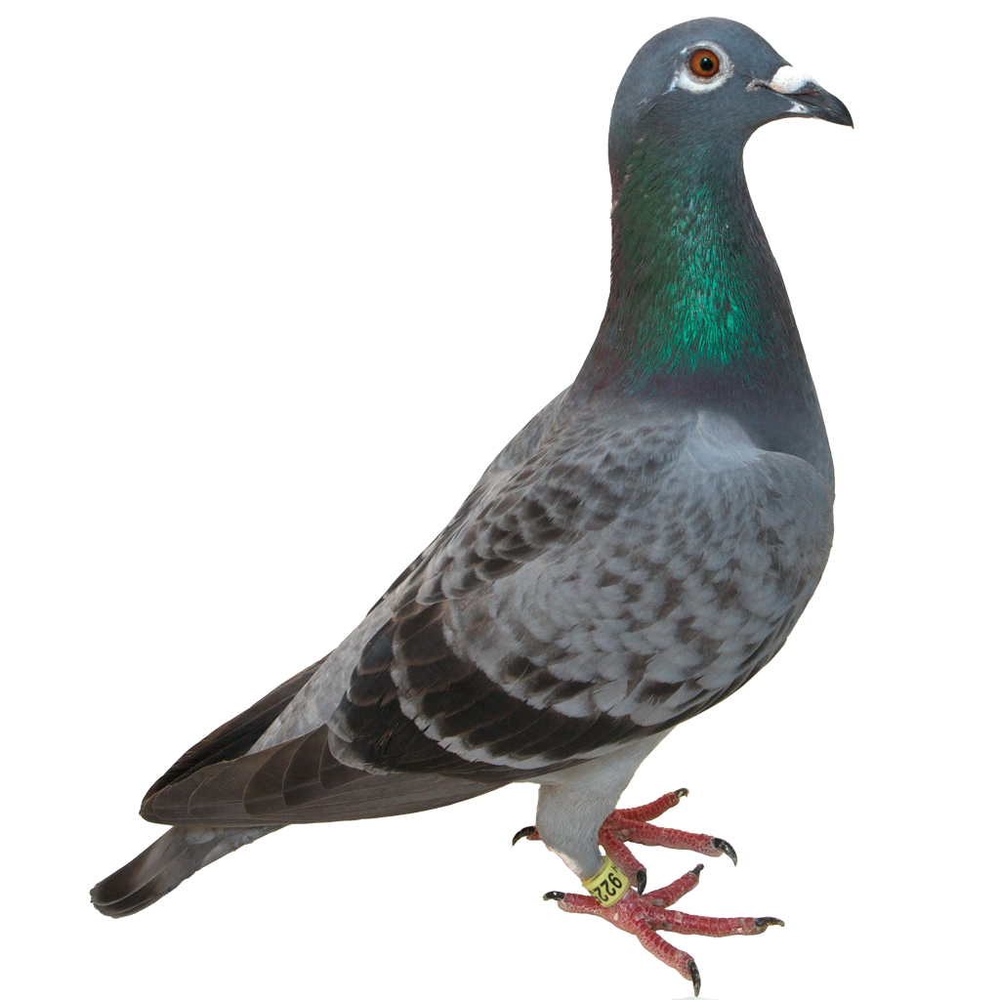
How to place these pigeons?
12 piegonholes
13 pigeons

Slide 35
How to place these pigeons?

Slide 36

The pigeonhole principle
If $k$ is a positive integer, and $k+1$ or more objects are placed into $k$ boxes, then there is at least one box that contains two or more objects
If there are more objects than capacity, then there must be at least one overflowed box

Slide 37

Generalized pigeonhole principle
If $N$ objects are placed into $k$ boxes, then there is at least one box containing at least $\left\lceil \frac{N}{k}\right\rceil$ objects
A better estimate on the degree of overflow

Slide 38

Example
Among 100 people, at least how many are guarenteed to be born in the same month?
Answer: $\left\lceil \frac{100}{12}\right\rceil =9$

Slide 39

Example
What should be the minimum number of students in a class so that at least six receives the same grade? (Possible grades: A, B, C, D, F)
Answer: $\left\lceil \frac{N}{5}\right\rceil =6$, so minimum value of $N$ is 26

Slide 40
Exercise
How many cards must be selected from a standard deck of 52 cards to guarentee that at least three cards of the same suit are chosen?

Slide 41

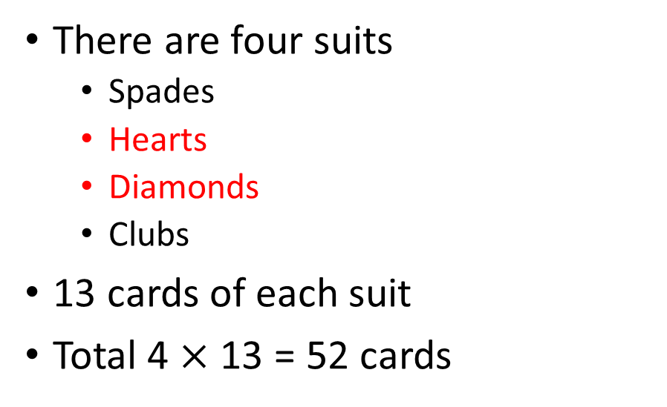
Cards tutorial
There are four suits
Spades
Hearts
Diamonds
Clubs
13 cards of each suit
Total 4 $×$ 13 = 52 cards

Slide 42
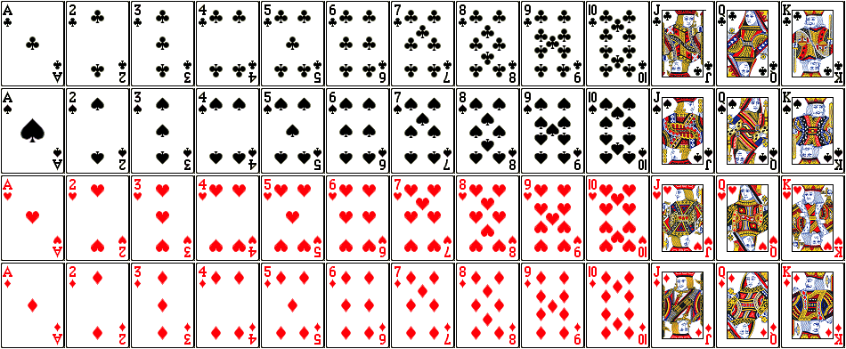

Slide 43
Exercise
How many cards must be selected from a standard deck of 52 cards to guarentee that at least three cards of the same suit are chosen?

Slide 44
Exercise
How many cards must be selected from a standard deck of 52 cards to guarentee that we have at least three hearts?

Slide 45
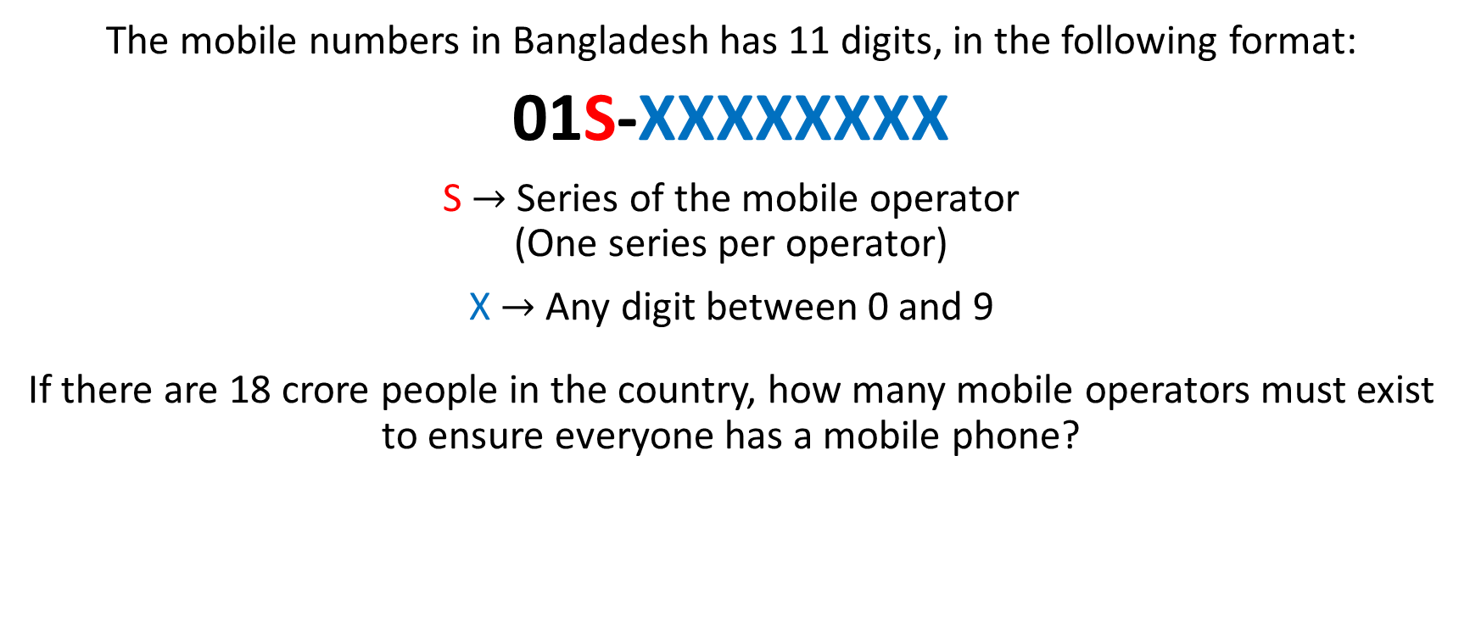
Exercise
The mobile numbers in Bangladesh has 11 digits, in the following format:
01S-XXXXXXXX
S $→$ Series of the mobile operator (One series per operator)
X $→$ Any digit between 0 and 9
If there are 18 crore people in the country, how many mobile operators must exist to ensure everyone has a mobile phone?

Slide 46
THE SUM RULE

Slide 47
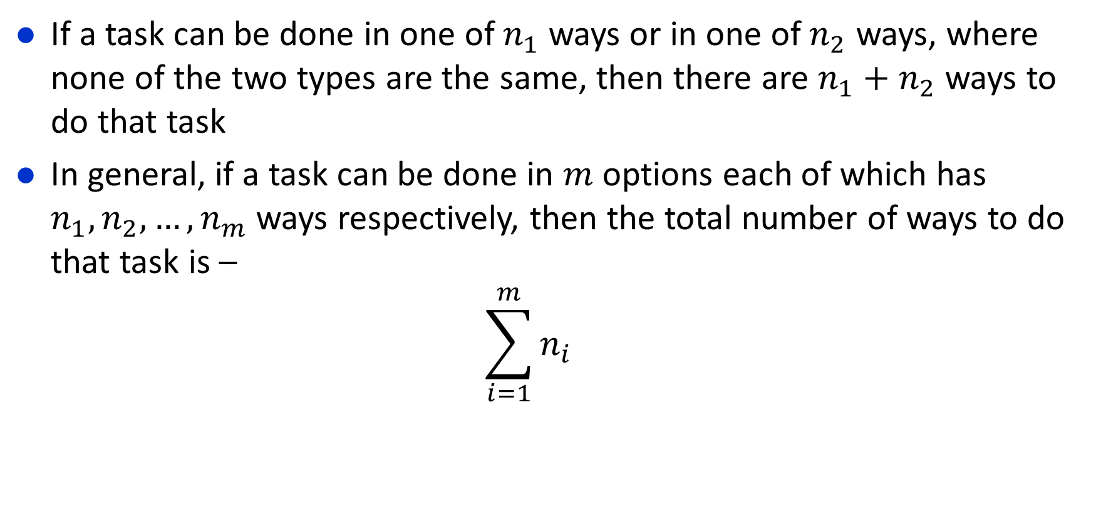
The Sum Rule

Slide 48
The Sum Rule
We can travel from Dhaka to Chattogram in bus, train or by air
How many buses are there?
Shohag, Green line, Hanif
How many trains are there?
Mahanagar, Subarna, Sonar Bangla, Turna
How many flights are there?
Novoair, US-Bangla
So how many ways we can travel?

Slide 49

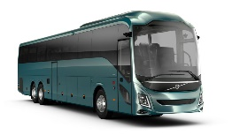

The Sum Rule
The task is TRAVEL FROM DHAKA TO CHITTAGONG
Question : How many ways can the task be done
The different ways of doing this task are:
Novo Air
US Bangla
Shohag
Green Line
Hanif
Dhaka
Ctg
Mahanagar
Subarna
Sonar Bangla
Turna

Slide 50
The Sum Rule
The task is TRAVEL FROM DHAKA TO CHITTAGONG
Question : How many ways can the task be done
The different ways of doing this task are:
2+3+4=9 ways
Novo Air
US Bangla
Shohag
Green Line
Hanif
Dhaka
Ctg
Mahanagar
Subarna
Sonar Bangla
Turna

Slide 51
Sum Rule
Step one: Identify the different options of doing the SAME task
The different options are going to be connected with an OR relationship
Step two: Count the possible ways for each options
Step three: Add the possible ways

Slide 52
The Sum Rule
Another Example
Suppose that either a member of the mathematics faculty or a student who is a mathematics major is chosen as a representative to a university committee. How many different choices are there for this representative if there are 37 members of the mathematics faculty and 83 mathematics majors and no one is both a faculty member and a student?

Slide 53
COMPLEX COUNTING PROBLEMS
Combining the Sum Rule and The Product Rule

Slide 54
Complex Counting problems
Example 15
You are being admitted to a new class, you were asked by your teacher to select an ID of one or two characters.
The ID can contain uppercase alphabets and numbers.
Moreover, a ID must begin with an alphabet and must be different from the five ids of length two that have been taken by 5 other students . (Suppose A1, BB, C1,D2, EF)
In how many ways can you select your ID?

Slide 55
Complex Counting problems
Example 16
Each user on a computer system has a password, which is six to eight characters long
Each character of a password is an uppercase letter or a digit.
Each password must contain at least one digit.
How many possible passwords are there?

Slide 56
SOME PROBLEMS FROM THE EXERCISE

Slide 57
Some Problems From the Exercise
3. A multiple-choice test contains 10 questions. There are four possible answers for each question.
a) In how many ways can a student answer the questions on the test if the student answers every question?
b) In how many ways can a student answer the questions on the test if the student can leave answers blank?
4. A particular brand of shirt comes in 12 colors, has a male version and a female version, and comes in three sizes for each gender. How many different types of this shirt are made?

Slide 58
Some Problems From the Exercise
5. Six different airlines fly from New York to Denver and seven fly from Denver to San Francisco. How many different pairs of airlines can you choose on which to book a trip from New York to San Francisco via Denver, when you pick an airline for the flight to Denver and an airline for the continuation flight to San Francisco?
6. There are four major auto routes from Boston to Detroit and six from Detroit to Los Angeles. How many major auto routes are there from Boston to Los Angeles via Detroit?

Slide 59
Some Problems From the Exercise
8. How many different three-letter initials with none of the letters repeated can people have?
9. How many three-letter initials are there that begin with an A
11. How many bit strings of length ten both begin and end with a 1?
15. How many strings are there of lowercase letters of length four or less, not counting the empty string?
16. How many strings are there of four lowercase letters that have the letter x in them?

Slide 60
Some Problems From the Exercise
17. How many strings of five ASCII characters contain the character @ (“at” sign) at least once? [Note: There are 128 different ASCII characters.]
19. How many 6-element RNA sequences
a) do not contain U?
b) end with GU?
c) start with C?
d) contain only A or U?

Slide 61
Some Problems From the Exercise
33. How many strings of eight English letters are there
a) that contain no vowels, if letters can be repeated?
b) that contain no vowels, if letters cannot be repeated?
c) that start with a vowel, if letters can be repeated?
d) that start with a vowel, if letters cannot be repeated?
e) that contain at least one vowel, if letters can be repeated?
f ) that contain exactly one vowel, if letters can be repeated?
g) that start with X and contain at least one vowel, if letters can be repeated?
h) that start and end with X and contain at least one vowel, if letters can be repeated?

Slide 62
Thank You

Slide 63


